Slide 1
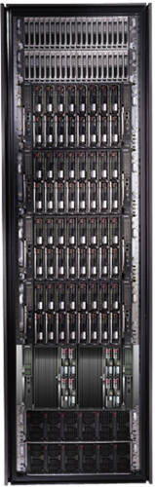
Programming clusters with DryadLINQ
Mihai Budiu
Microsoft Research, Silicon Valley
HPC & GPU Supercomputing Group of Silicon Valley Dec 5, 2011

Slide 2
Design Space
Grid
Internet
Data-
parallel
Search
X
Shared
memory
Data
center
Transaction
HPC
Latency
(interactive)
Throughput
(batch)
Notes:
Dryad is optimized for: throughput, data-parallel computation, in a private data-center.

Slide 3
Software Stack
Applications
Language (DryadLINQ)
Execution (Dryad)
Storage (Distributed Storage Catalog)
Cluster (Windows HPC Cluster)
Windows Server
Windows Server
Windows Server
Windows Server

Slide 4
Data-Parallel Computation
Application
SQL
Sawzall, Java
≈SQL
LINQ, SQL
Parallel Databases
Sawzall,FlumeJava
Pig, Hive
DryadLINQ Scope
Language
Map-Reduce
Hadoop
Dryad
Execution
GFS BigTable
HDFS
DSC
Storage

Slide 5

Dryad
Execution layer of Bing analytics
Continuously deployed since 2006
Running on >> 10⁴ machines
Sifting through > 10Pb data daily
Runs on clusters > 3000 machines
Handles jobs with > 10⁵ processes each
Platform for rich software ecosystem
The Dryad by Evelyn De Morgan.

Slide 6
Dryad = Execution Layer
Job (application)
Pipeline
≈
Dryad
Shell
Cluster
Machine
Notes:
In the same way as the Unix shell does not understand the pipeline running on top, but manages its execution (i.e., killing processes when one exits), Dryad does not understand the job running on top.

Slide 7

2-D Piping
Unix Pipes: 1-D
grep | sed | sort | awk | perl
Dryad: 2-D
grep¹⁰⁰⁰ | sed⁵⁰⁰ | sort¹⁰⁰⁰ | awk⁵⁰⁰ | perl⁵⁰
Notes:
Dryad is a generalization of the Unix piping mechanism: instead of uni-dimensional (chain) pipelines, it provides two-dimensional pipelines. The unit is still a process connected by a point-to-point channel, but the processes are replicated.

Slide 8
Virtualized 2-D Pipelines
Notes:
This is a possible schedule of a Dryad job using 2 machines.

Slide 9


Virtualized 2-D Pipelines

Slide 10

Virtualized 2-D Pipelines

Slide 11
Virtualized 2-D Pipelines

Slide 12
Virtualized 2-D Pipelines
2D DAG
multi-machine
virtualized
Notes:
The Unix pipeline is generalized 3-ways:
2D instead of 1D
spans multiple machines
resources are virtualized: you can run the same large job on many or few machines

Slide 13
Dryad Job Structure
Channels
Input files
Stage
Output files
grep
sort
awk
sed
perl
grep
sort
sed
awk
grep
sort
Vertices (processes)
Notes:
This is the basic Dryad terminology.

Slide 14
Dryad System Architecture
data plane
Files, TCP, FIFO, Network
job schedule
V
V
V
NS, Sched
RE
RE
RE
control plane
Graph manager
cluster
Notes:
The brain of a Dryad job is a centralized graph manager, which maintains a complete state of the job.
The GM controls the processes running on a cluster, but never exchanges data with them.
(The data plane is completely separated from the control plane.)

Slide 15



Fault Tolerance
Notes:
Vertex failures and channel failures are handled differently.

Slide 16

LINQ
=> DryadLINQ
Dryad
Notes:
DryadLINQ adds a wealth of features on top of plain Dryad.

Slide 17
LINQ = .Net+ Queries
Collection<T> collection;
bool IsLegal(Key);
string Hash(Key);
var results = from c in collection where IsLegal(c.key) select new { Hash(c.key), c.value};
Notes:
Language Integrated Query is an extension of .Net which allows one to write declarative computations on collections (green part).

Slide 18
Collections
class Collection<T> : IEnumerable<T>;
Iterator
(current element)
Elements of type T

Slide 19

DryadLINQ Data Model
.Net objects
Partition
Collection

Slide 20

DryadLINQ = LINQ + Dryad
Collection<T> collection;
bool IsLegal(Key k);
string Hash(Key);
var results = from c in collection where IsLegal(c.key) select new { Hash(c.key), c.value};
Vertex code
Query plan
(Dryad job)
Data
collection
C#
C#
C#
C#
results
Notes:
DryadLINQ translates LINQ programs into Dryad computations:
- C# and LINQ data objects become distributed partitioned files.
- LINQ queries become distributed Dryad jobs.
- C# methods become code running on the vertices of a Dryad job.

Slide 21
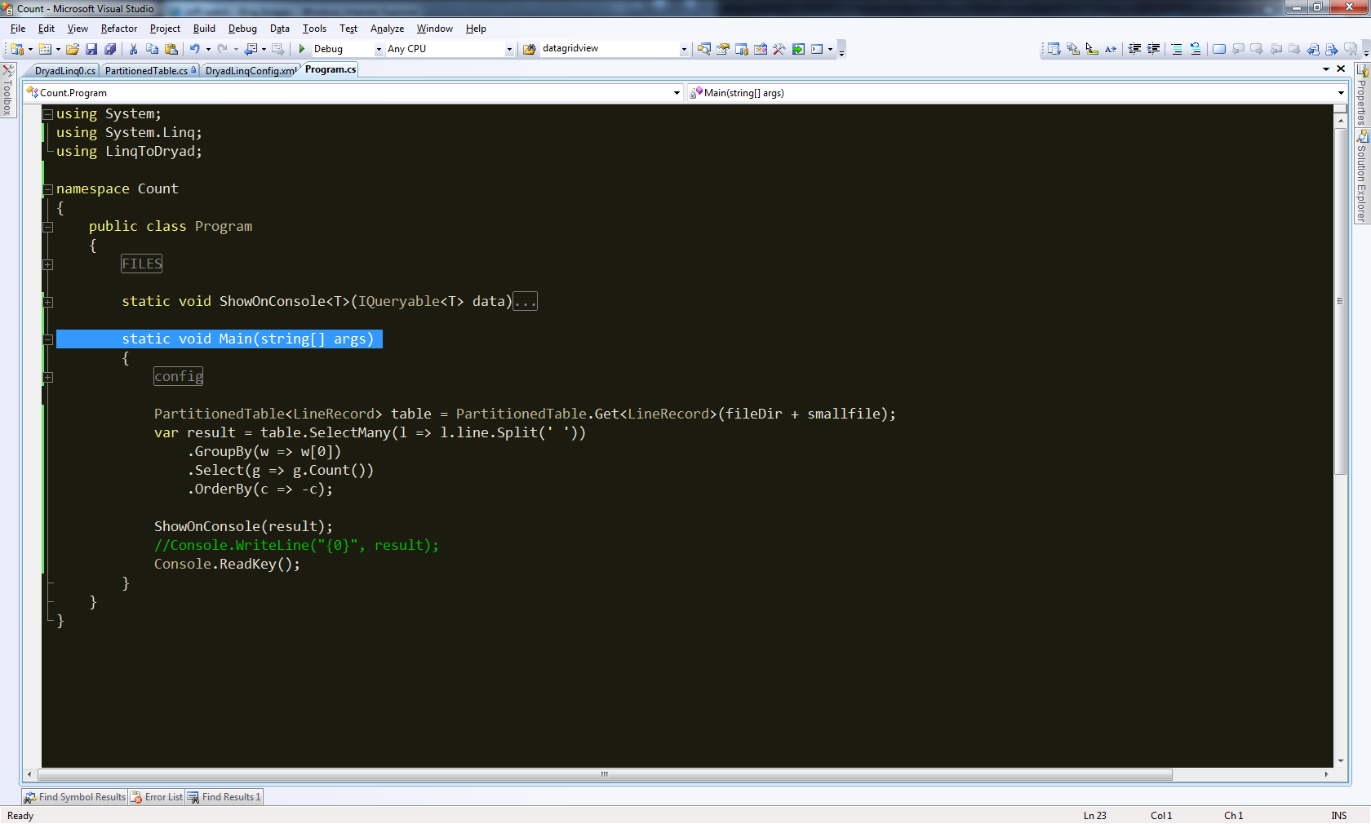
Demo

Slide 22
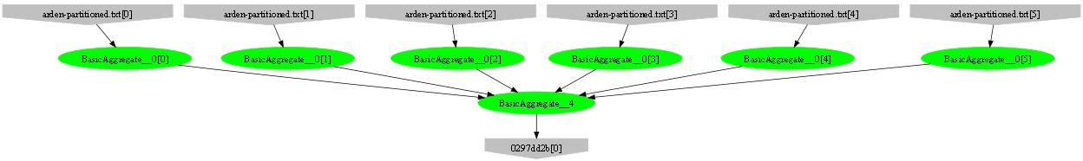
Example: counting lines
var table = PartitionedTable.Get<LineRecord>(file);
int count = table.Count();
Parse, Count
Sum

Slide 23
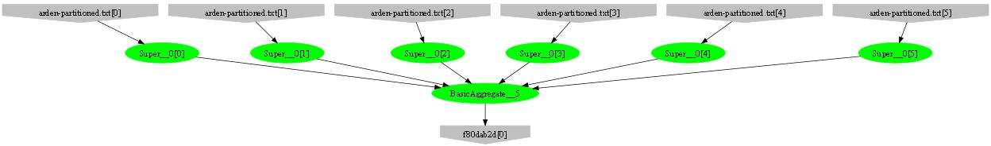
Example: counting words
var table = PartitionedTable.Get<LineRecord>(file);
int count = table .SelectMany(l => l.line.Split(‘ ‘))
.Count();
Parse, SelectMany, Count
Sum

Slide 24
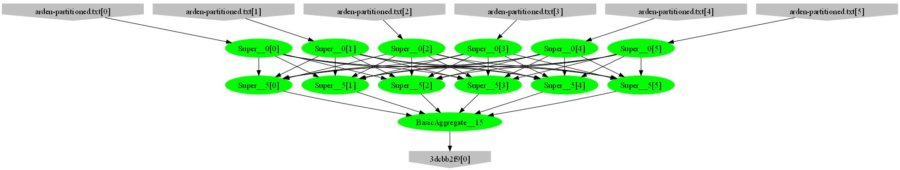
Example: counting unique words
var table = PartitionedTable.Get<LineRecord>(file);
int count = table .SelectMany(l => l.line.Split(‘ ‘))
.GroupBy(w => w)
.Count();
HashPartition
GroupBy;
Count

Slide 25
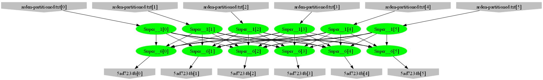
Example: word histogram
var table = PartitionedTable.Get<LineRecord>(file);
var result = table.SelectMany(l => l.line.Split(' '))
.GroupBy(w => w)
.Select(g => new { word = g.Key, count = g.Count() });
GroupBy
Count
HashPartition
GroupBy;
Count

Slide 26
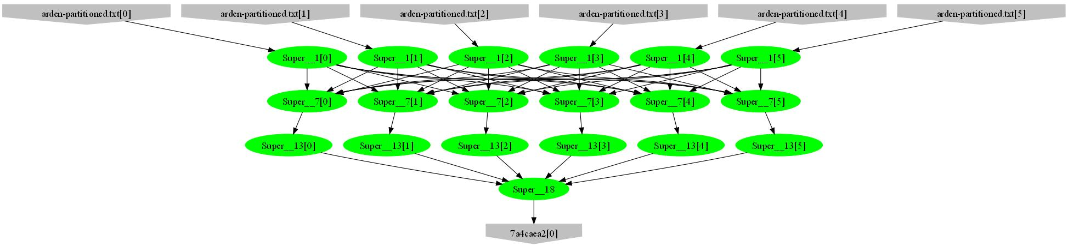
Example: high-frequency words
var table = PartitionedTable.Get<LineRecord>(file);
var result = table.SelectMany(l => l.line.Split(' '))
.GroupBy(w => w)
.Select(g => new { word = g.Key, count = g.Count() })
.OrderByDescending(t => t.count)
.Take(100);
Sort; Take
Mergesort; Take

Slide 27
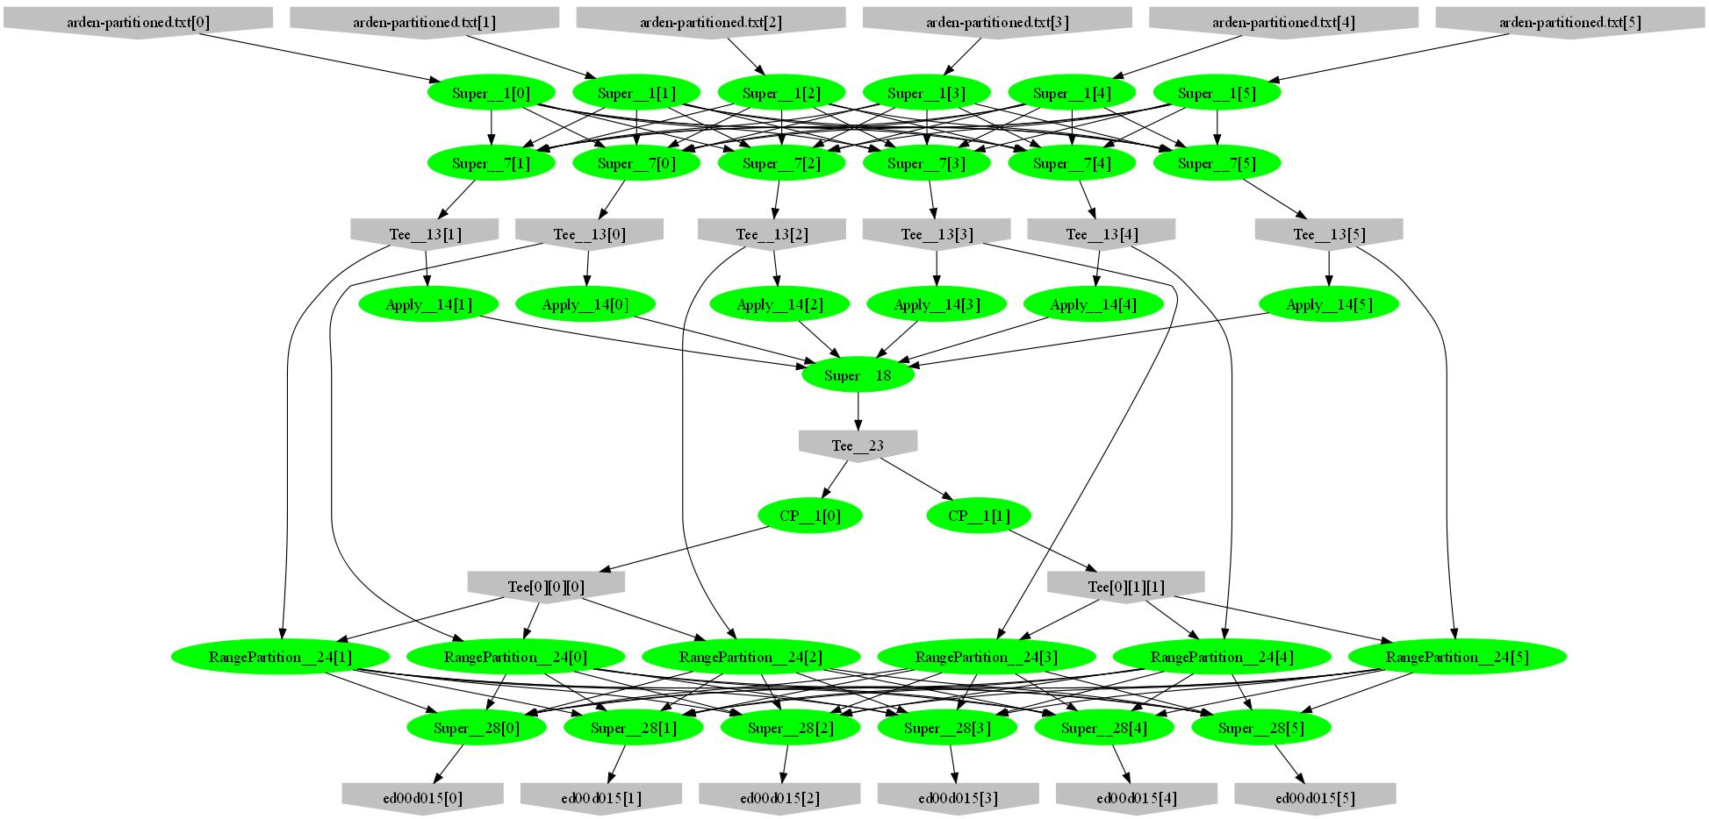
Example: words by frequency
var table = PartitionedTable.Get<LineRecord>(file);
var result = table.SelectMany(l => l.line.Split(' '))
.GroupBy(w => w)
.Select(g => new { word = g.Key, count = g.Count() })
.OrderByDescending(t => t.count);
Sample
Histogram
Broadcast
Range-partition
Sort

Slide 28
Example: Map-Reduce
public static IQueryable<S> MapReduce<T,M,K,S>(
IQueryable<T> input,
Func<T, IEnumerable<M>> mapper,
Func<M,K> keySelector,
Func<IGrouping<K,M>,S> reducer)
{
var map = input.SelectMany(mapper);
var group = map.GroupBy(keySelector);
var result = group.Select(reducer);
return result;
}

Slide 29
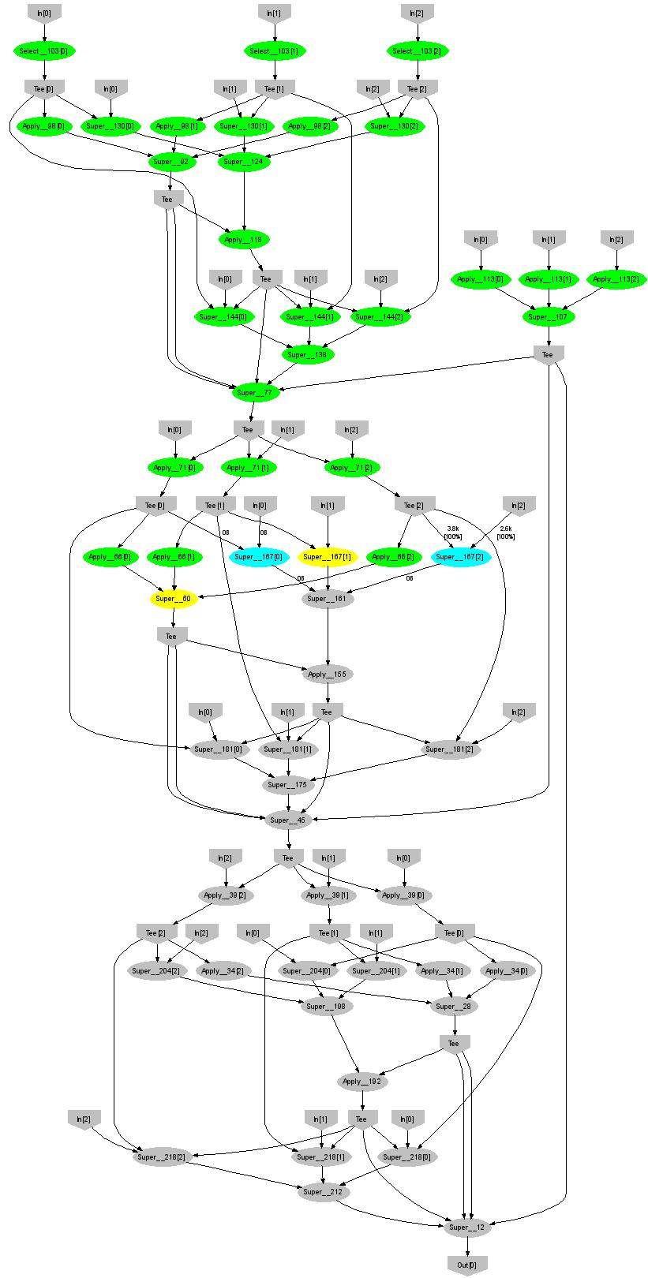
Expectation Maximization
160 lines
3 iterations shown
Notes:
More complicated, even iterative algorithms, can be implemented.

Slide 30
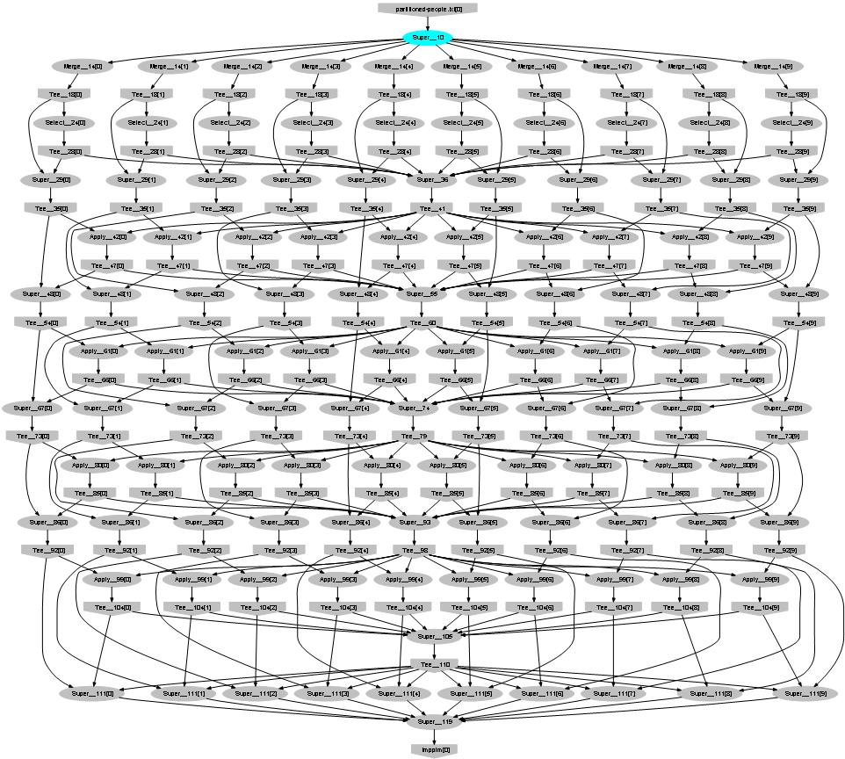
Probabilistic Index Maps
Images
features

Slide 31
Language Summary
Where
Select
GroupBy
OrderBy
Aggregate
Join

Slide 32
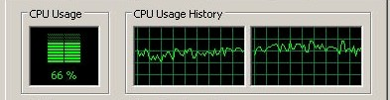
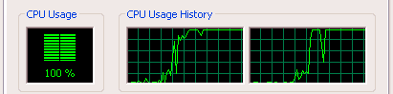
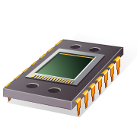
Using PLINQ
Query
LINQ to HPC
Local query
PLINQ
Notes:
At the bottom LINQ to HPC uses LINQ to run the computation in parallel on multiple cores.

Slide 33

So, What Good is it For?

Slide 34

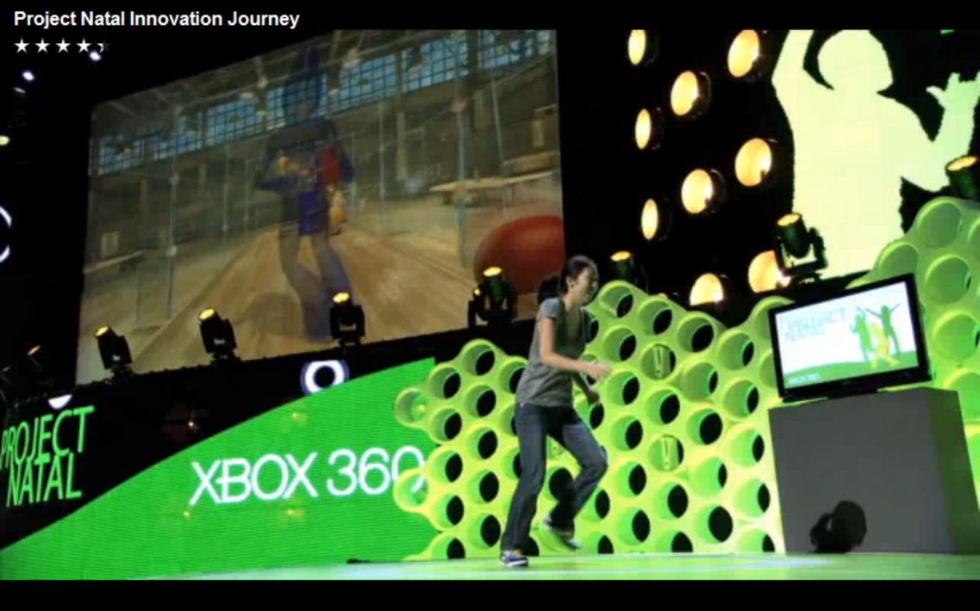
Application: Kinect Training

Slide 35
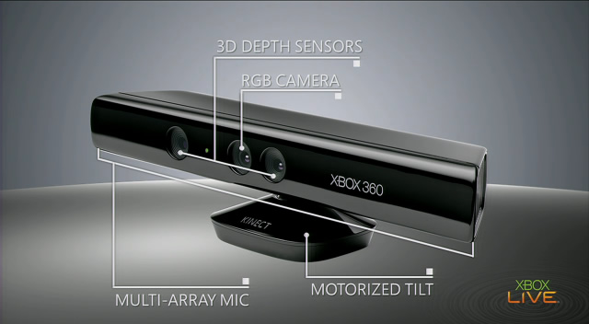
Input device

Slide 36

Depth computation
Source: http://nuit-blanche.blogspot.com/2010/11/unsing-kinect-for-compressive-sensing.html

Slide 37


Vision Input: Depth Map + RGB

Slide 38



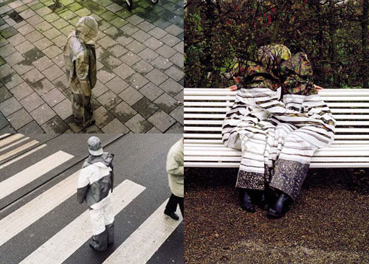

Why is it hard?

Slide 39

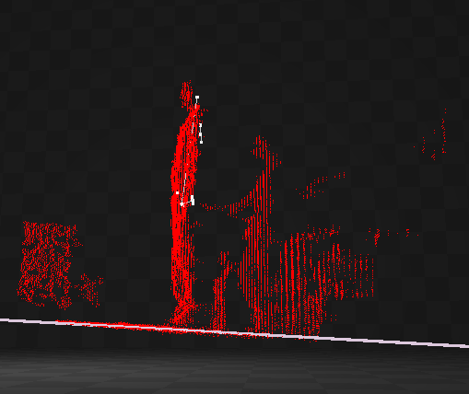
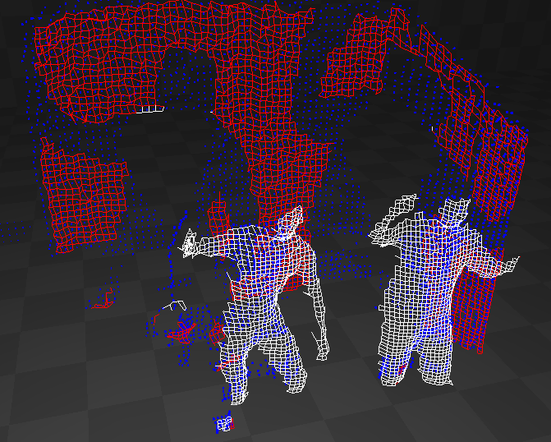
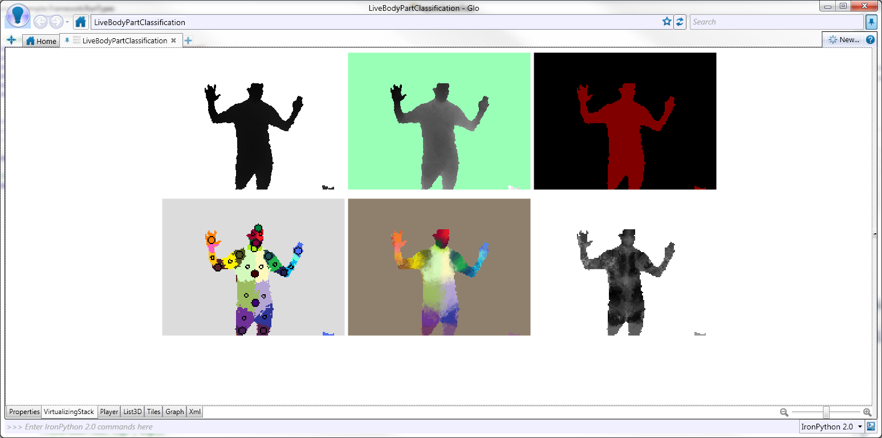

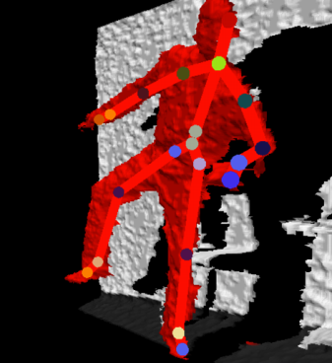
Skeletal Tracking Pipeline
Sensor
Depth map
Background segmentation
Player separation
Body Part Classifier
Body Part Identification
Skeleton

Slide 40
The Classifier
Classifier
Input
Depth map
Runs on GPU @ 320x240
Output
Body parts

Slide 41


Motion Capture

Slide 42
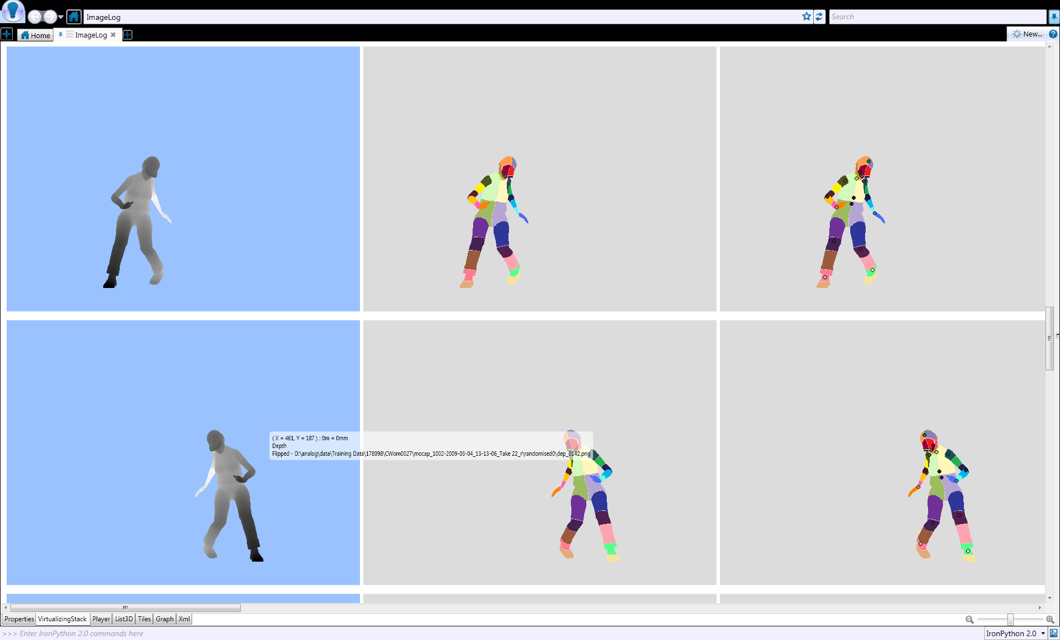
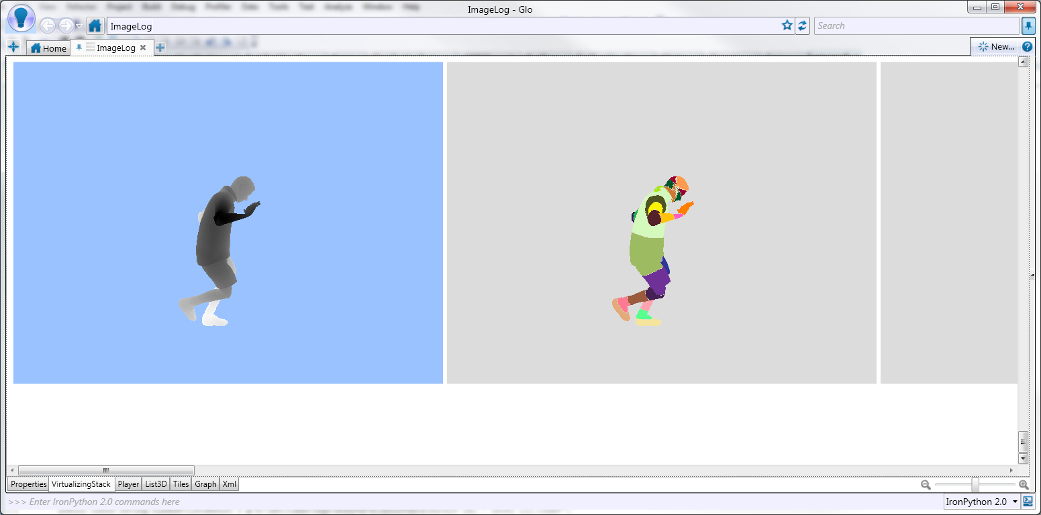
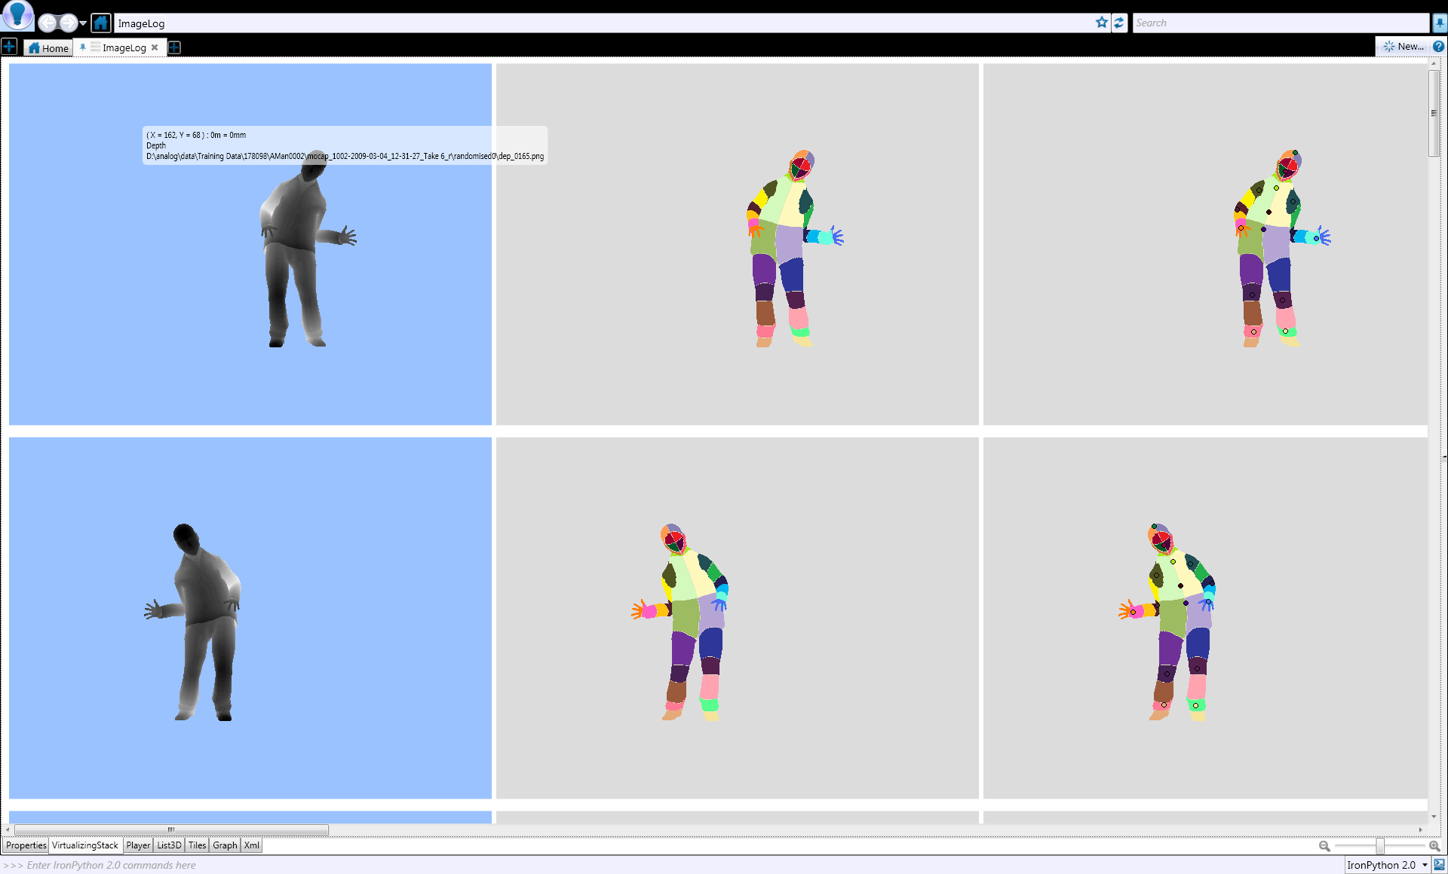
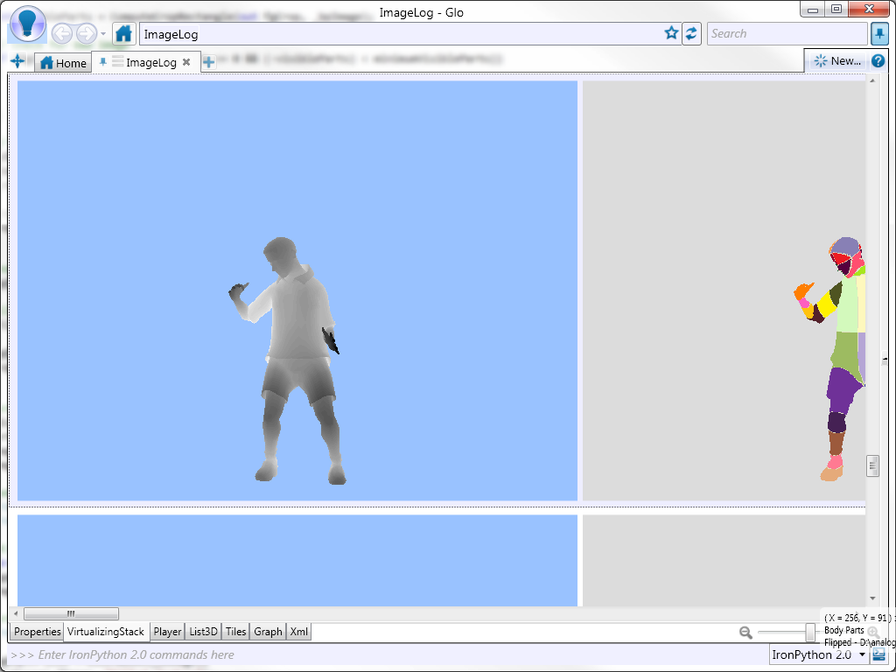
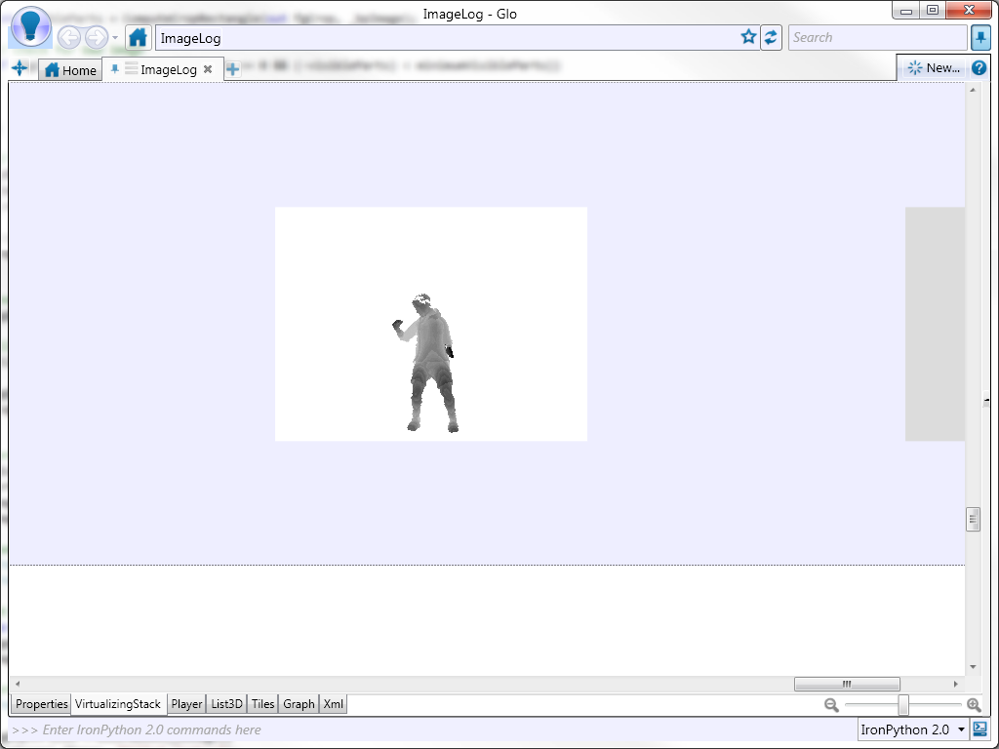
Ground Truth Data
3D avatar model

Slide 43

Learn from Data
Training examples
Machine learning
Classifier

Slide 44
Kinect Training
Decision
forest
Millions of examples needed
Machine learning
DryadLINQ
Dryad
Cluster

Slide 45
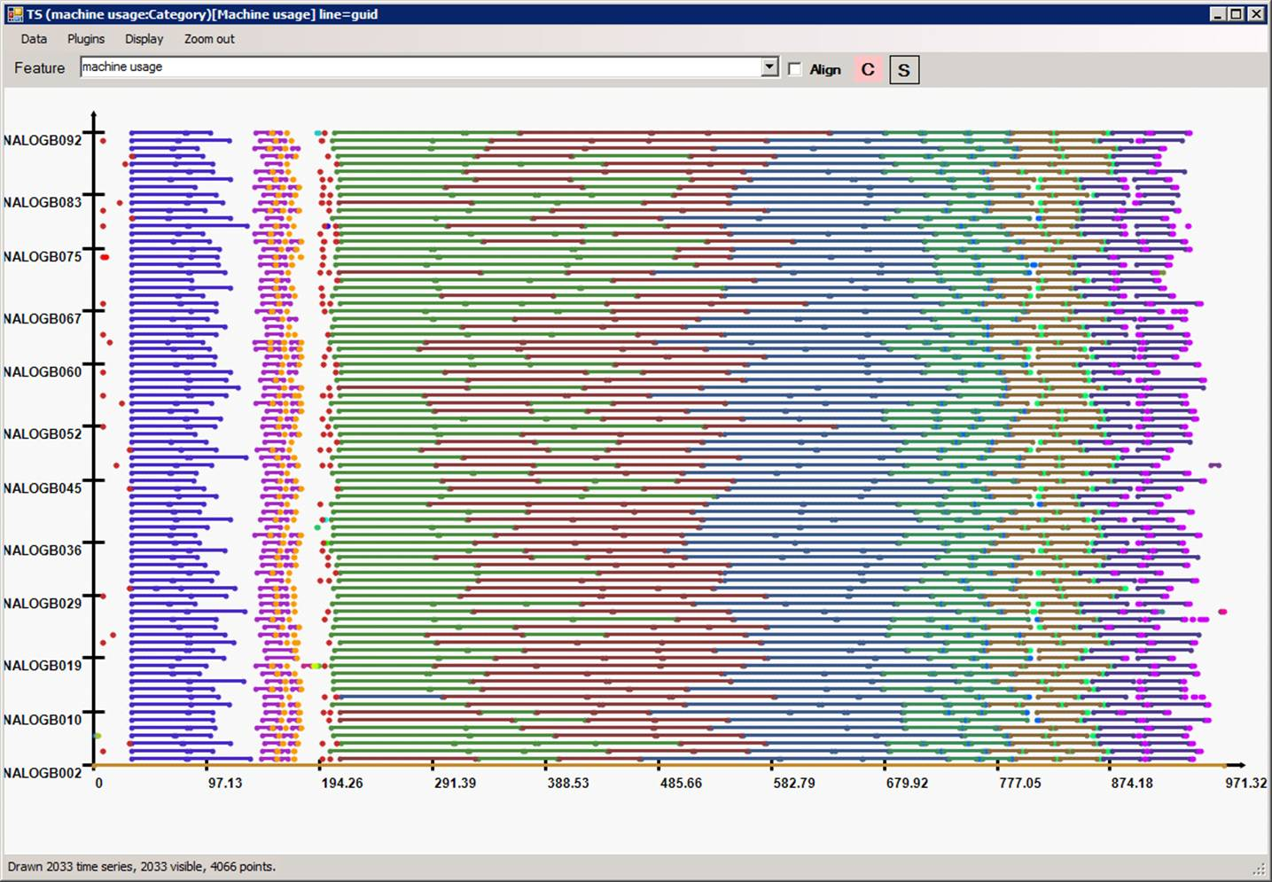
Highly efficient parallellization
machine
time

Slide 46
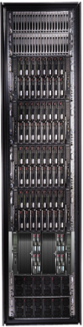

Conclusions
Cluster
LINQ
Dryad
=
46
Notes:
We believe that Dryad and LINQ to HPC are a great foundation for cluster computing.

